Slide 1
Figure 1
Research Funding Trends* (critical for Economic
Competitiveness and Security Technological Leadership)
*Sources: Top Fig.: David Mowery “ Military R&D and Innovation” (University of California Press, 2007); Lower Fig.: National Science Foundation, S&E Indicators 2006; OECD, Main S&T Indicators database, Nov. 2004
“Critical Importance of an Effective and Efficient Defense Industrial Base” ~ II Forum of Defense and Security Industry ~ Bogota, Columbia |10.23.2014

Slide 2
Figure 2
Historic Example of potential benefits: at the
Parts level: Commercial Vs. Military Semiconductors
For Same Environment and Performance
COMMERCIAL MIL SPEC
PART COST
Bi-polar digital logic $1.67 $15.78
Bi-polar linear $0.42 $11.40
RELIABILITY FAILURE INDEX (ppm) 0.06 1.9 – 4.6
LEAD TIME NEW PART 1-12 months 17-51 months
After seeing this (and other comparable data) on the “Packard Commission”, Defense Secretary Perry issued a Directive for DoD to “use Commercial Specs and Standards” (which has not been followed)
*Sources: “A Quest for Excellence”-“The President‘s Blue Ribbon Commission Defense Acquisition;”
(from Packard Commission), June 1986

Slide 3
Figure 3
Problems in DoD DoD’s Acquisitions
Caused Increased Regulation and Oversight
Increasing Costs and Driving Away Commercial Firms
OMB and SBA estimated Regulatory Compliance costs of $1.752 trillion in 2008 (up from $1.1 trillion in 2005 and $843 billion in 2001)**
Note 1: That the sum of corp. tax and individual taxes in 2011 was $1.402 trillion (far less than the estimated regulatory compliance costs).
Note 2: The TASC/Coopers and Lybrand study of the 18% “regulatory cost impact on DoD purchases” was done in 1994. A 2014 Air Force report said the regulatory cost increase is now 25%.

Slide 4
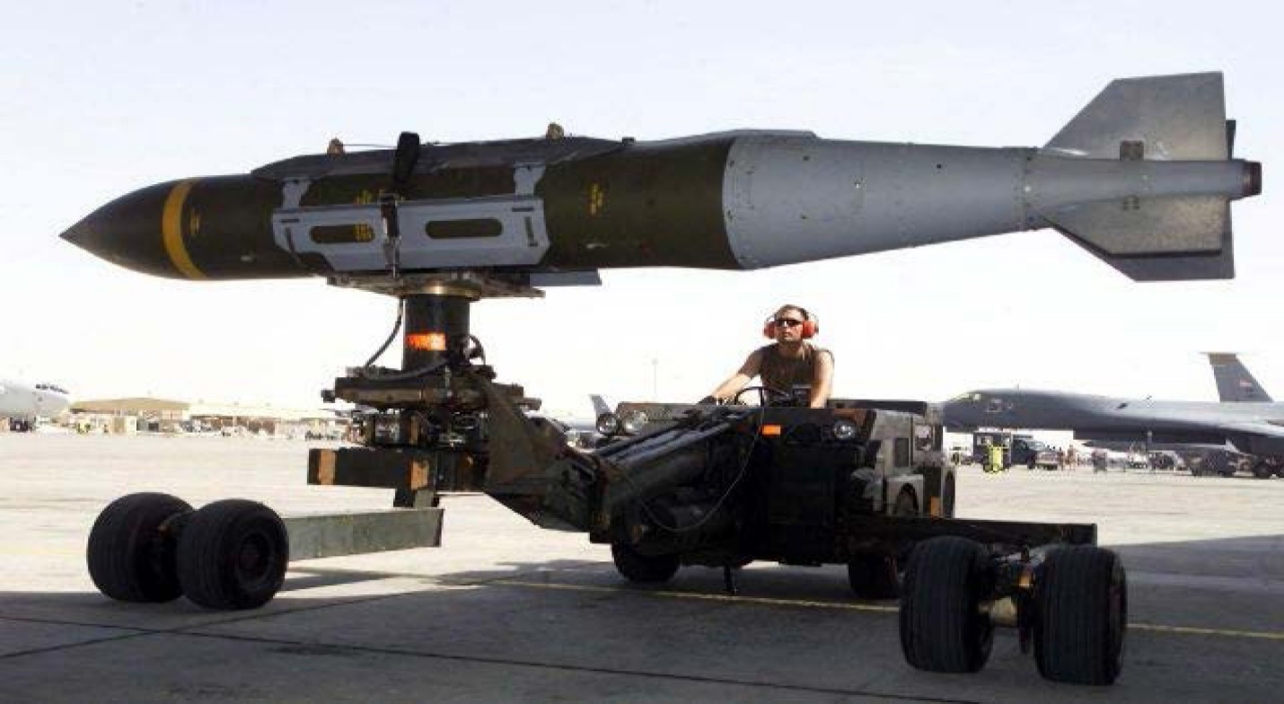
Figure 4
Unit Cost: Military Specification parts: $69,000 each; commercial parts: $18,000 each
Joint Direct Attack Munition (JDAM)

Slide 5
Figure 5
Where Do Key Innovations Come From?

