Slide 1

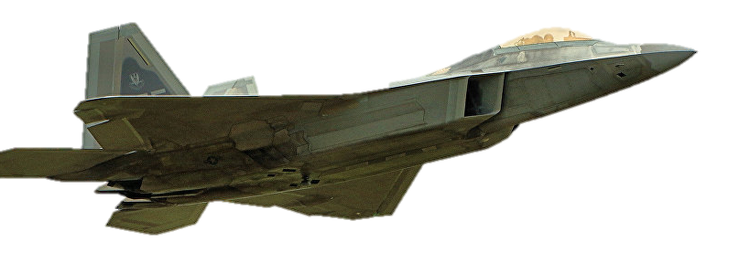




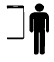




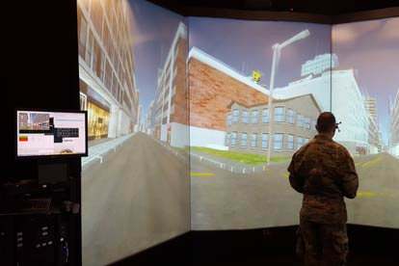
DOD Supports Spectrum for 5G
Unclassified
Ligado is not offering a 5G solution
DoD recognizes the value of
5G to the nation and its benefit
to both the military and
commercial interests
To ensure U.S. global technology competitiveness in 5G, DoD acknowledges the need to share mid-band spectrum
DoD is actively engaged in 5G experimentation examining ways
to successfully share mid-band spectrum to become the world premiere 5G leader while protecting national security
Established a team of experts to assess and review technical and operational proposals to enable spectrum sharing
Smart Ports / Bases
EXPERIMENTS
Smart Warehouses and Logistics
Dynamic Spectrum Sharing
Augmented/Virtual Reality-Distributed Training
Unclassified

